Slide 1
An Embedded System Development for Field Workers Safety Detection
Embedded System Final Project
Proposal
Group 7

Slide 2
Outline
Motivation
System Block Diagram
Fall Detection
Introduction to AHRS
Expected Result

Slide 3
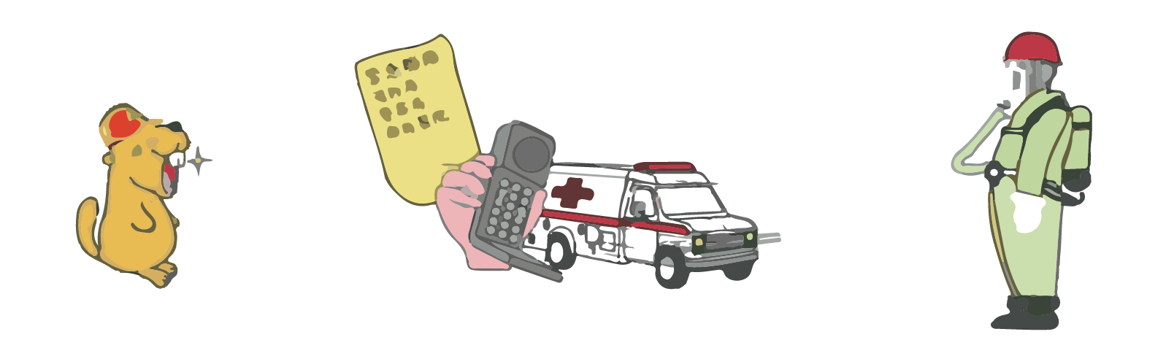
Motivation
Workplace accidents are sometimes due to insufficient manpower allocation and confined space. For these conditions, it may cause more damage if the worker cannot seek rescue in time.
Wearable devices like wristbands, watches and necklaces are not allowed in workplace.
Hence, we’re trying to propose a fall detection system, which should achieve these design features:
Low cost
Lightweight
Low power consumption
Real-time monitoring
Automatic alarm systems
FIRST AID IN EMERGENCY
OF CONFINED SPACE
ALARM
CALL
PROTECT
Picture source: 勞動部職業安全衛生署

Slide 4

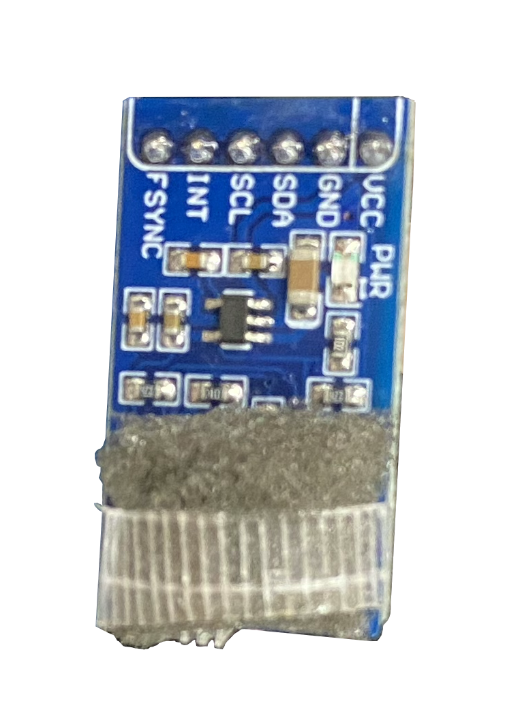
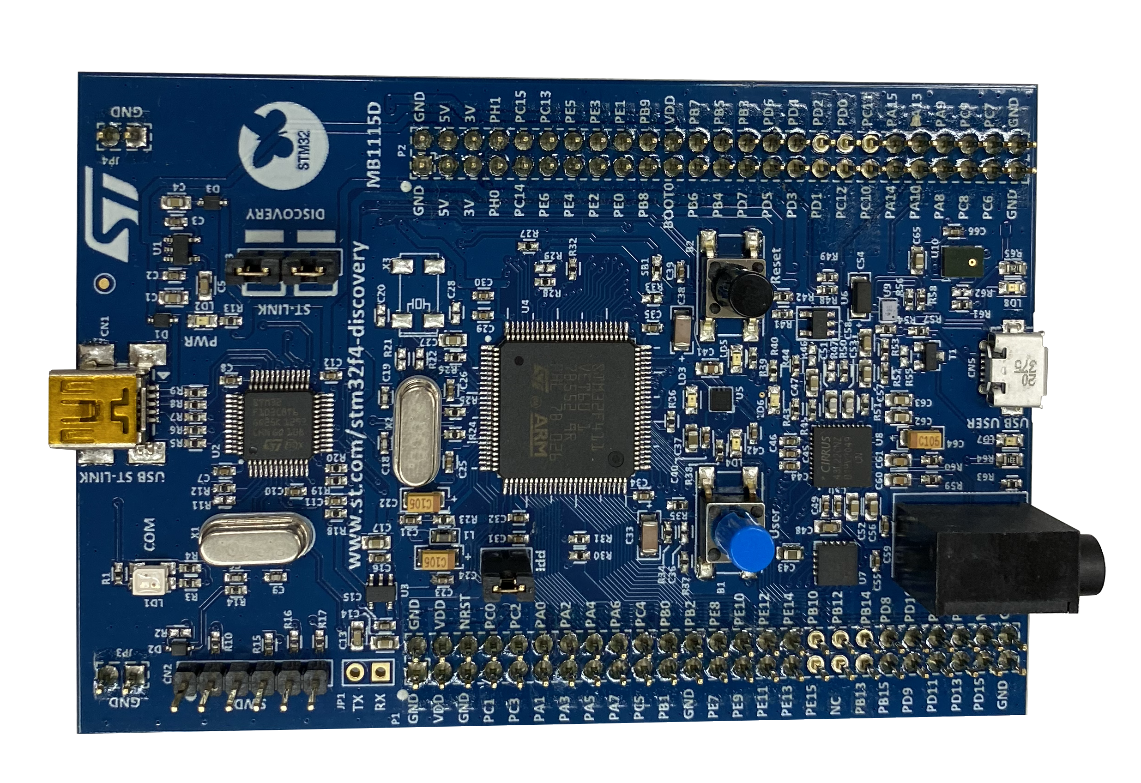
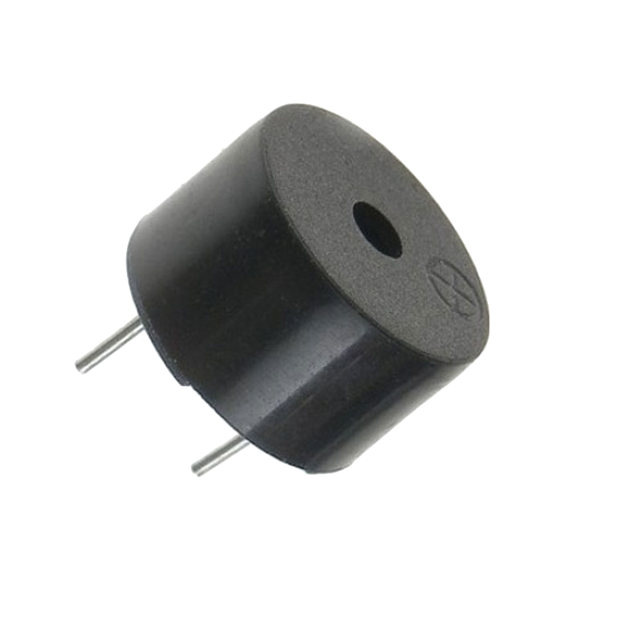
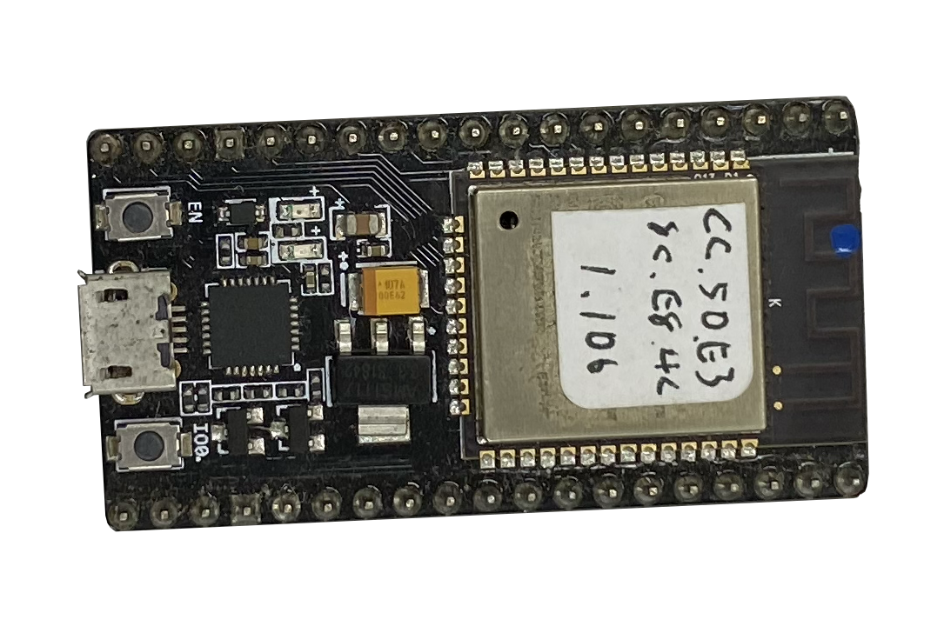

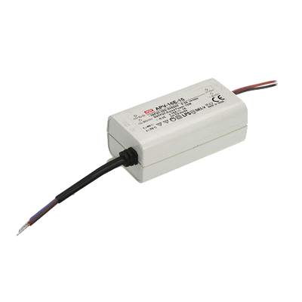
System Block Diagram
GUI monitor
+
Alarm
Host
Head-mounted Device
Sensor
Core: AHRS + Fall Detection
Wi-Fi communication
Linear acceleration
Angular velocity
Magnetic field
Attitude
Fall alarm
MPU 9255
(6-axis IMU + Magnetometer)
STM32F411VE +
Buzzer / SD card / power supplier
ESP32 or ESP8266

Slide 5
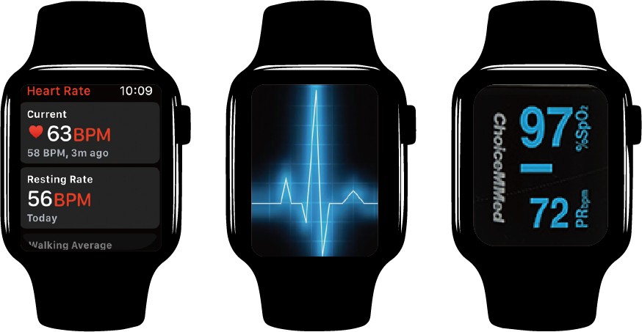
Fall Detection (1/2)
Hardware for Example
Apple Watch
Components
Heart rate variability (HRV), electrocardiogram (ECG), pulse oximetry (SPO2), and kinematic attributes measured by accelerometers, gyroscope, and magnetometer.
(Ramachandran and Karuppiah 2020)

Slide 6
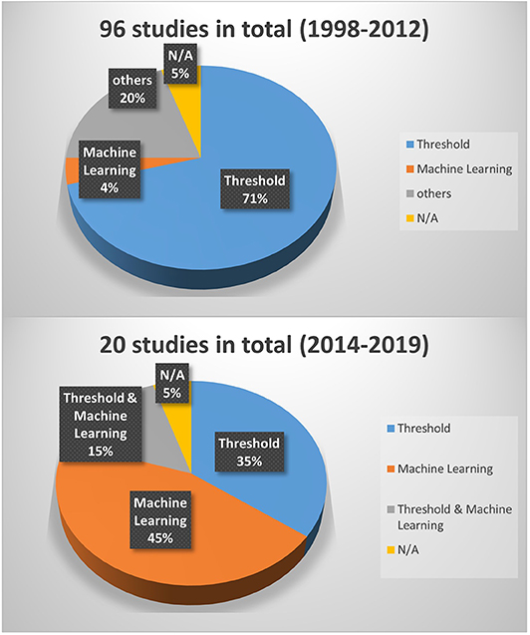
Fall Detection
Critical Point
Tell the difference between falling and other actions.
Method
Analytical
Thresh-Holding technique
Machine Learning
AHRS
(Wang, Ellul et al. 2020)
Sensor
Fall detection
Data collection
Data Processing
Feature Extraction
Call out
Start
End
no
(Hussain, Umair et al. 2019)

Slide 7
Brief Introduction of AHRS
Attitude/Orientation
The orientation of a body in the three-dimensional space.
It usually is represented by related rotation of the body frame with respect to the global frame.
AHRS = Attitude and Heading Reference System
A System that determines the attitude/orientation of a body.
It used multiple sensors (accelerometer, gyroscope, magnetometer) and fuses the measurements each other to acquire a reliable attitude estimate.
The inertia measurement unit (IMU) provides these measurements.
In this project, the AHRS will be implemented in the STM32F411VE for attitude determination.
Body Frame
Global Frame
Notes:
接下來，將介紹 何謂 AHRS 演算法，以及 AHRS 在本次研究中所扮演的腳色。
(第一點)
首先，先介紹「姿態」這個名詞。所謂的姿態，指的是一個物體在三維空間中的擺向。
通常，我們會用 body frame 相對於 global frame 的相對旋轉來描述一個物體的姿態。
(第二點)
而進行姿態估測與解算的這個次系統，我們就把它稱為 AHRS，即航姿參考系統。
AHRS通常應用了多個傳感器，正確地說，常用到「加速規」、「陀螺儀」、以及「磁力計」，來進行所謂的 sensor fusion 來得到一個可信的姿態估測量。
實際上，我們可以在 IMU 裡面找到這些傳感器。
(第三點)
在本次專題，我們將把 AHRS 演算法實作於 STM32F4 這塊開發版，作為我們安全偵測演算法的一環。
接下來，我們將展示預期的實作成果。

Slide 8
Introduction to AHRS (1/3)
Attitude/Orientation
The orientation of a body in the three-dimensional space.
It usually is represented by related rotation of the body frame with respect to the global frame.
AHRS = Attitude and Heading Reference System
A System that determines the attitude/orientation of a body.
It used multiple sensors (accelerometer, gyroscope, magnetometer) and fuses the measurements each other to acquire a reliable attitude estimate.
The inertia measurement unit (IMU) provides these measurements.
The famous AHRS algorithms include:
Complementary Filter
Mahony Filter
Madgwick Filter
Kalman Filters
Body Frame
Global Frame

Slide 9
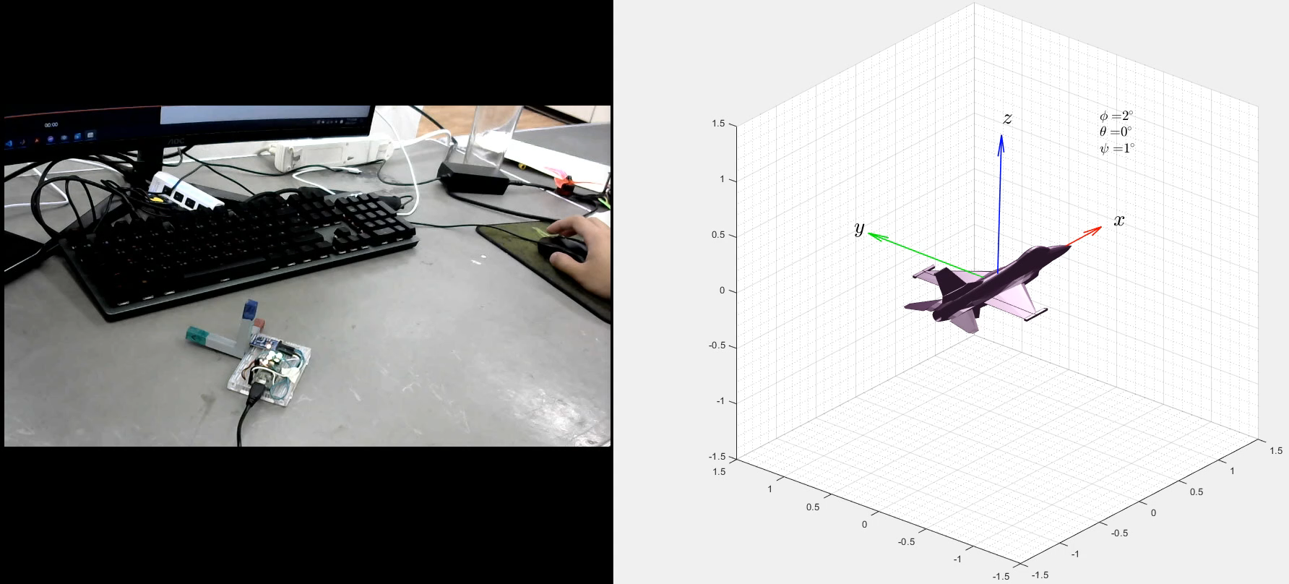
Introduction to AHRS (2/3)

Slide 10
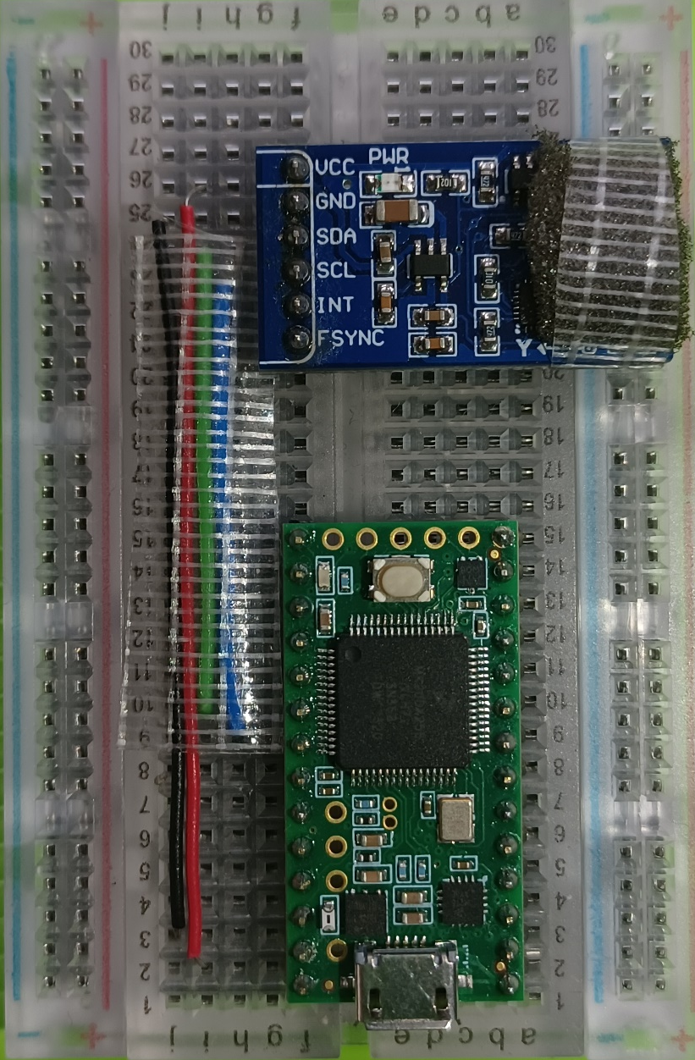
Introduction to AHRS (3/3)
MPU-9255 (IMU Sensor)
Teensy 3.2 (ARM Cortex-M4 72MHz MCU)
In this project, the AHRS will be implemented in the STM32F411VE for attitude determination.
The motion sensor, MPU-9255, is used for sensing
linear acceleration (accelerometer),
angular velocity (gyroscope), and
magnetic field (compass/magnetometer).

Slide 11
Introduction to AHRS (/)
The mathematical approaches for representing the attitude include:
Euler angles (3 parameters)
Quaternions (4 parameters)
Rotation Matrix (9 parameters)
Quaternion-based Attitude Kinematics:
is the angular function.
is the unit quaternion;

Slide 12
Expected Results
Notes:
我們預計將上述所介紹到的系統架構，實作到影片中所示的安全帽帽裡面，STM32F4開發板會作為中央運算的核心元件，而 AHRS 以及 fall detection algorithms 將會寫入板子，在 worker 遭遇到特定情形，如，倒地時，發出警示聲，並藉由無線傳輸即時通知塔台，以達到黃金救援3分鐘之目標。

Slide 13
References
[1] F. Hussain et al., "An efficient machine learning-based elderly fall detection algorithm," arXiv preprint arXiv:1911.11976, 2019.
[2] A. Ramachandran and A. Karuppiah, "A survey on recent advances in wearable fall detection systems," BioMed research international, vol. 2020, 2020.
[3] X. Wang, J. Ellul, and G. Azzopardi, "Elderly fall detection systems: A literature survey," Frontiers in Robotics and AI, vol. 7, p. 71, 2020.
Notes:
May be useful
A wearable device for fall detection elderly people using tri dimensional accelerometer | IEEE Conference Publication | IEEE Xplore
SisFall: A Fall and Movement Dataset - PMC (nih.gov)

